Slide 1
Generative Adversarial Networks (GANs)
Ian Goodfellow et al.
Slides compiled by Niraj Mahajan for WiDS 2021

Slide 2
Structure of the presentation
Generative Models
Intro to GANs
Loss
Problems faced by GANs
W-GANs
Some other Interesting GANs

Slide 3
Generative Models

Slide 4
Generative Models vs Discriminative Models
Discriminative models discriminate between different kinds of data instances.
Capture the conditional probability p(Y | X).
Generative models can generate new data instances.
Capture the joint probability p(X, Y), or just p(X) if there are no labels

Slide 5
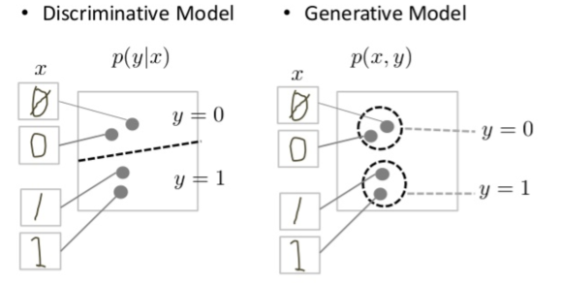
ctd
Neither kind of model has to return a number representing a probability. You can model the distribution of data by imitating that distribution.

Slide 6
2. Introduction to GANs

Slide 7
GANs
“GAN” is more like a method to train generative models to produce fake data.
The GAN model architecture involves two sub-models:
Generator: Model that is used to generate new plausible examples from the problem domain.
Discriminator: Model that is used to classify examples as real (from the domain) or fake (generated).
Both models are made to compete against each other in an adversarial game.
The discriminator is updated to get better at discriminating real and fake samples and the generator is updated based on how well, or not, the generated samples fooled the discriminator.

Slide 8
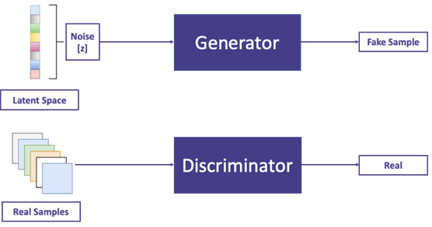
ctd

Slide 9
3. GAN Loss

Slide 10
Some Notation
D - Discriminator function
D(x) → Probability of x being a real image
G - Generator function
G(z) → Generated sample using input noise ‘z’
θ_{D} - Discriminator weights
θ_{G} - Generator weights
z - Noise vector
P_{z}(z) - Noise distribution
P_{data}(x) - Original Data distribution
P_{G}(x) - Generated Data distribution

Slide 11
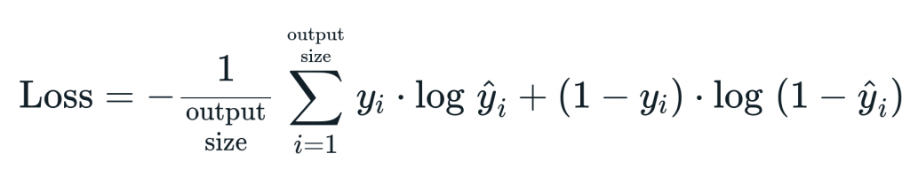
Recall - The Binary Cross Entropy Loss
Loss = - { }
Here y_{i} is the true label, is the predicted label.

Slide 12
Discriminator Loss
The discriminator wants to distinguish between the real and fake data
For x ~ P_{data} & z ~ P_{z} , the discriminator wants -
D(x) to be 1
D(G(z)) to be 0
We want to maximise log[ D(x) ]
We want to minimise log[ D(G(z)) ] ⇒ maximise log[ 1 - D(G(z)) ]
Discriminator Goal:
maximise { log[ D(x) ] + log[ 1 - D(G(z)) ] }

Slide 13
Generator Loss
The discriminator wants to fool the discriminator to classify fake data as real
For x ~ P_{data} & z ~ P_{z} , the generator wants -
D(x) to be 0
D(G(z)) to be 1
We want to minimise log[ D(x) ]
We want to maximise log[ D(G(z)) ] ⇒ minimise log[ 1 - D(G(z)) ]
Discriminator Goal:
minimise { log[ D(x) ] + log[ 1 - D(G(z)) ] }

Slide 14
GAN - loss
For any data x, noise z-
GAN Loss = min_{G} max_{D} { log[ D(x) ] + log[ 1 - D(G(z)) ] }
But since we need to consider our entire dataset, we take expectation over x, z

Slide 15
4. Problems faced by GANs

Slide 16
Mode Collapse
If a generator produces an especially plausible output, the generator may learn to produce only that output.
If the generator starts producing the same outputs repeatedly, the discriminator's best strategy is to learn to always reject that output.
But if the discriminator gets stuck in a local minima, then it’s too easy for the Generator
Such a phenomenon is called mode collapse

Slide 17
Non Convergence
In an ideal training scenario, the discriminator’s accuracy is 50% - a coin toss.
Thus the discriminator performance gets worse because the discriminator can't easily tell the difference between real and fake.
Hence, the discriminator feedback gets less meaningful over time.
So if the GAN continues to train beyond this point, the generator quality will deteriorate.
It is not guaranteed that a GAN will always converge.

Slide 18
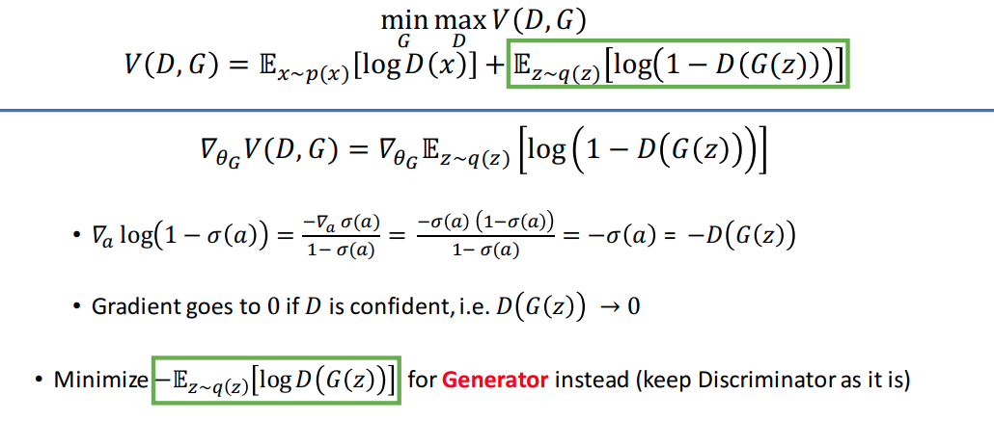
Vanishing Gradient?

Slide 19
5. Wasserstein GANs

Slide 20
Wasserstein GANs!
Discriminator does not actually classify instances - generates scores
The threshold is not 0!
Eg. The discriminator might learn score > 4 as real & score <= 4 as fake
D cannot discriminate between real and fake - hence called critic.
Critic Loss:
D(x) - D(G(z))
Generator Loss:
D(G(z))
Refer here for a tutorial on WGANs.

Slide 21
WGAN continued
While deriving the loss for WGANs, the authors assume Lipschitz Continuity for the Critic
The WGAN paper gave a workaround to this by clipping the weights of the model in some range. But even the authors mentioned that ”Weight clipping is clearly a terrible way to enforce a Lipschitz constraint”.
Alternately, we can impose a gradient penalty
L_{discriminator}=score_{fake} − score_{real}+ λ ∗ (||gradient||₂−1)²

Slide 22
6. Other Interesting GANs

Slide 23
A GAN Zoo?
https://github.com/hindupuravinash/the-gan-zoo
DCGAN
cGAN
InfoGAN
AC-GAN
Pix2Pix
Cycle-GAN
Context Encoder
StyleGAN - IMPORTANT FOR THIS PROJECT!

Slide 24
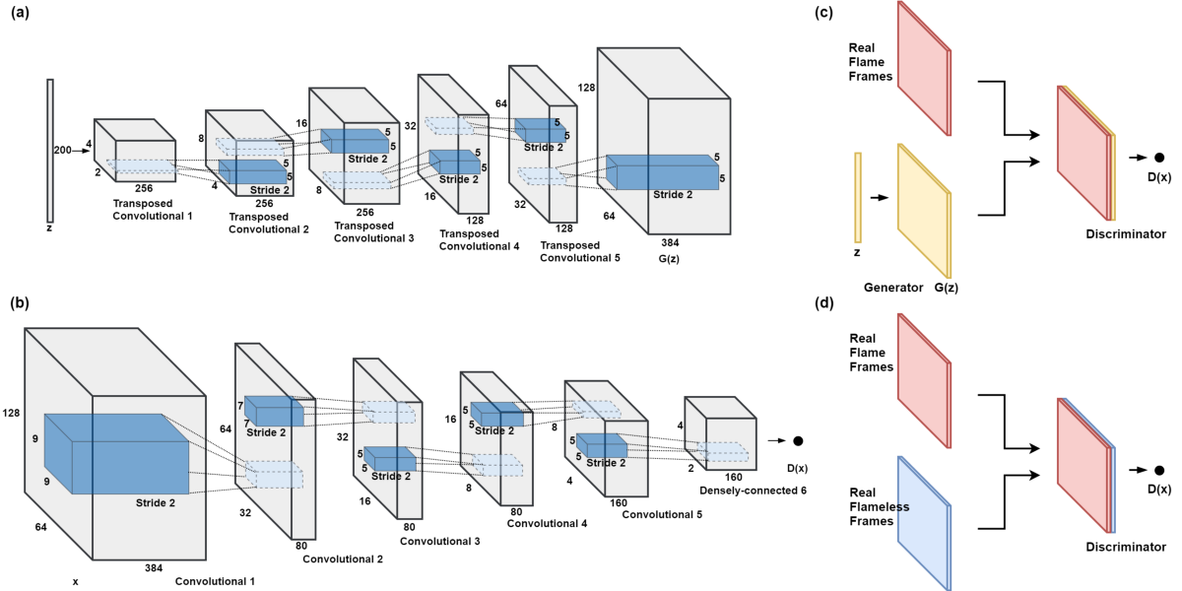
DCGAN - Deep Convolution GAN

Slide 25
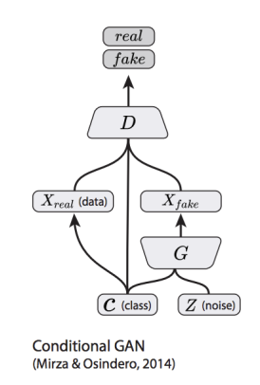
cGAN - Conditional GAN
Takes advantage of labels during the training process.
Generator models the joint distribution P(X,y)
Discriminator models the distribution P(X | y)

Slide 26
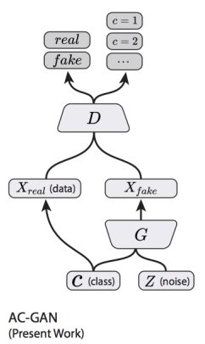
AC-GAN - Auxiliary Classifier GAN
Extension of class-conditional GAN
Discriminator predicts the ‘class label’ of the given image.
Stabilises the training, gives excellent results

Slide 27
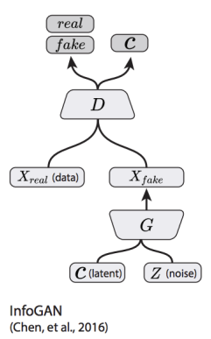
InfoGAN - Auxiliary Classifier GAN
Provide a “latent code” to the generator as input
The codes are then made meaningful by maximizing the Mutual Information between the code and the generator output.

Slide 28
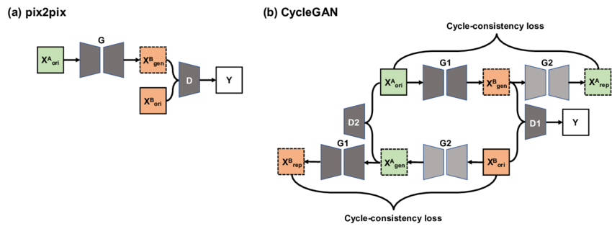
Pix2Pix and Cycle GAN
Used for Image to Image Translation

Slide 29
References
https://machinelearningmastery.com/what-are-generative-adversarial-networks-gans/
https://arxiv.org/abs/1406.2661
http://slazebni.cs.illinois.edu/spring17/lec11_gan.pdf

